Slide 1


Slide 2
Abstract
Naukri.com is an entrepreneurial firm that pioneered online recruitment and the Internet was in its infancy.
It obtained some venture capital funding in the year 1000 and has been earning profits since 2002-03 Revenues had doubled every year since 2000-01 and were set to reach Rs 400 million in 2004-05 naukri.com had emerged as the leader in the online recruitment space in India and in November 2004 Sanjeev Bikhrhandani.
The firm's founder, was pandering over the firms’s challenges of growth Viewed from the perspective of the entrepreneurial life cycle Price, 2004).

Slide 3
objective
Naukari testing helps in searching and getting the job oppurtunities.

Slide 4
Proposed work
First login to the naukri website or the application
Sign up with your email or the phone number
Enter the correct OTP received to your mail or the mobile number
Create your username and password
Then search for your available jobs
Enter your details and the qualifications
Then run the code in the appium

Slide 5
1 Login I’d
2 Verify the password
3.Search the jobs
4. Persons details
5. Employment rate
6. UnEmoyment rate
7.available jobs percentage
8.filtering details
9.sorting
10. run in the appium

Slide 6
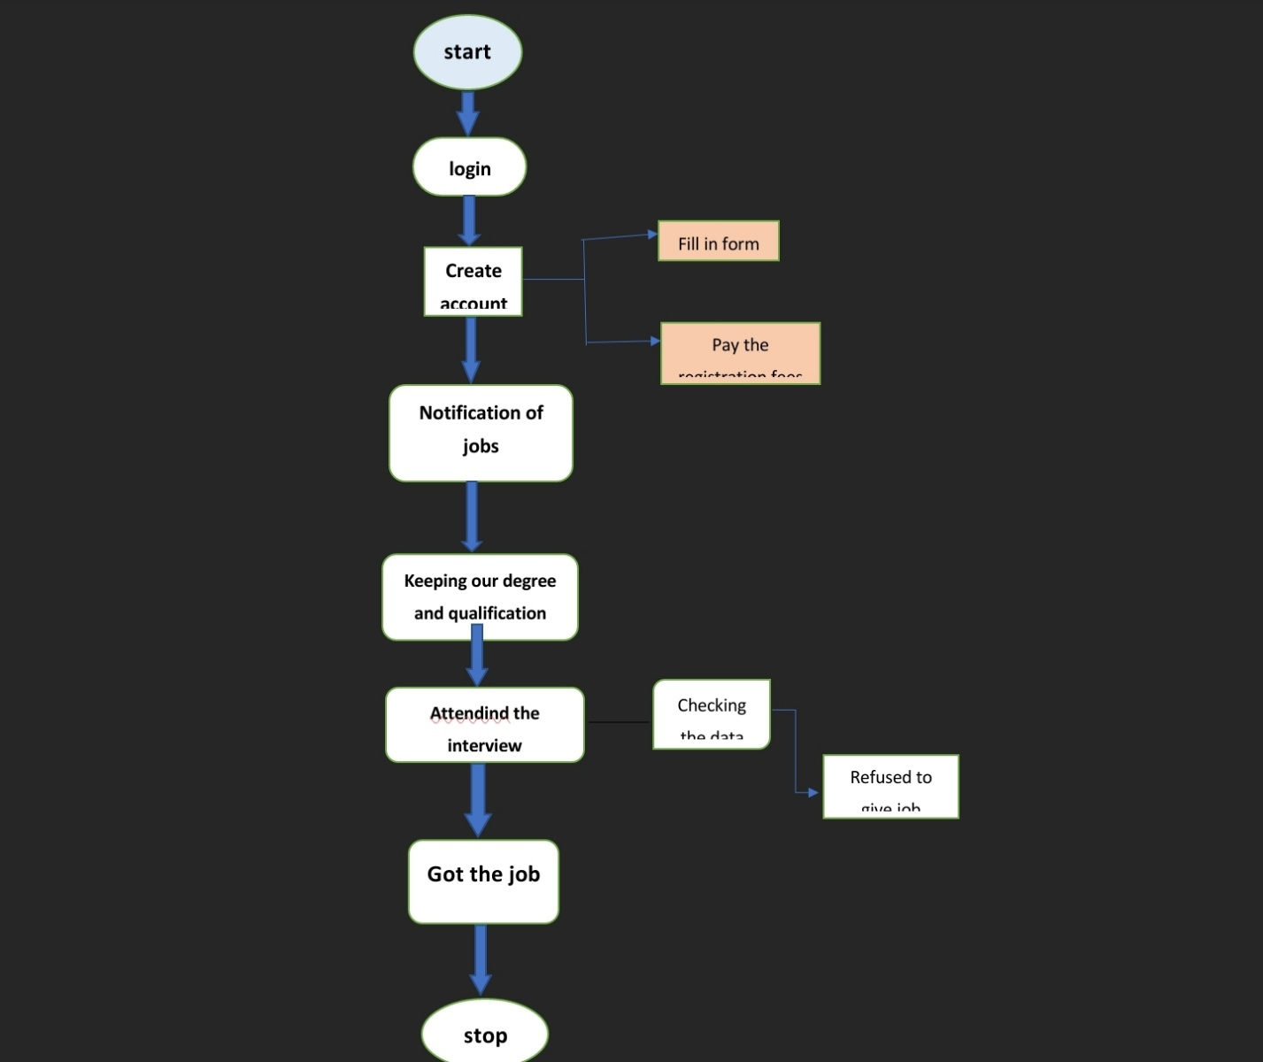
Flow chart

Slide 7
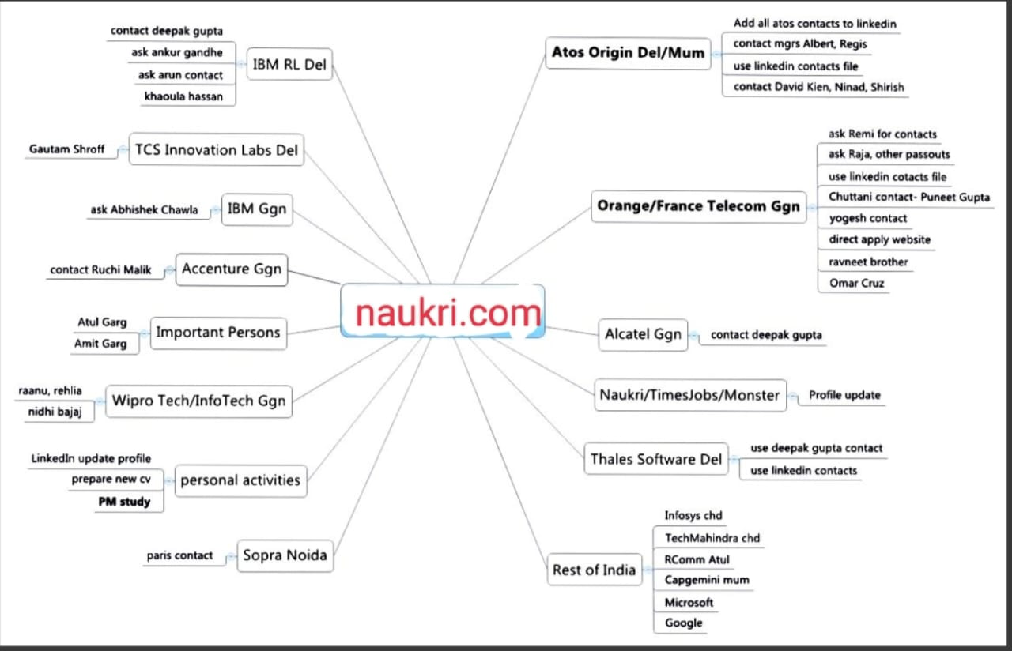
Concept map

Slide 8
Apps tools and installation
Software
Android studio
Xamp
WINDOWS LAPTOP
Appium
SQL lite database

Slide 9
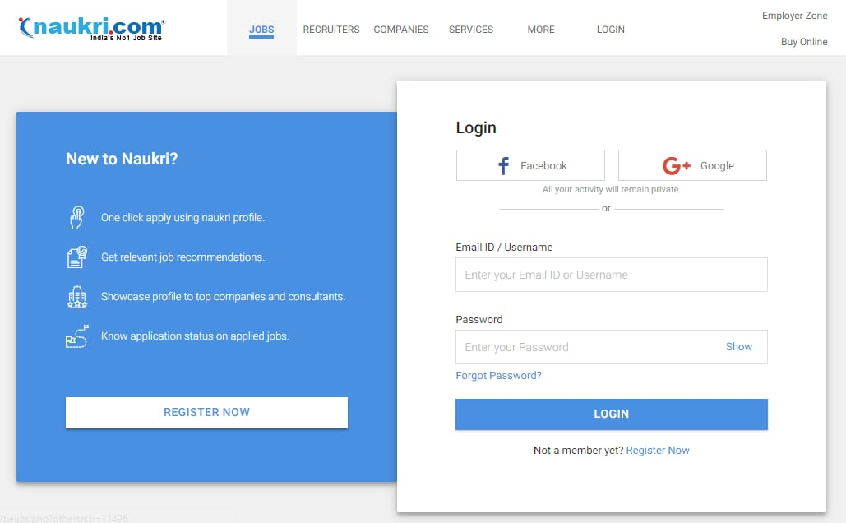
Screen shots

Slide 10
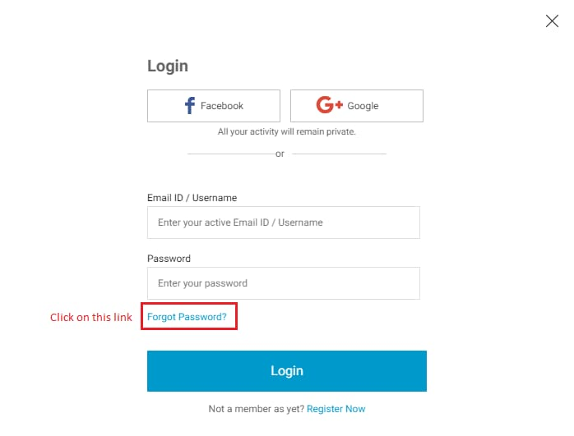

Slide 11
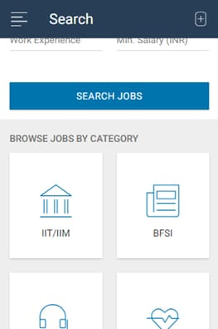

Slide 12
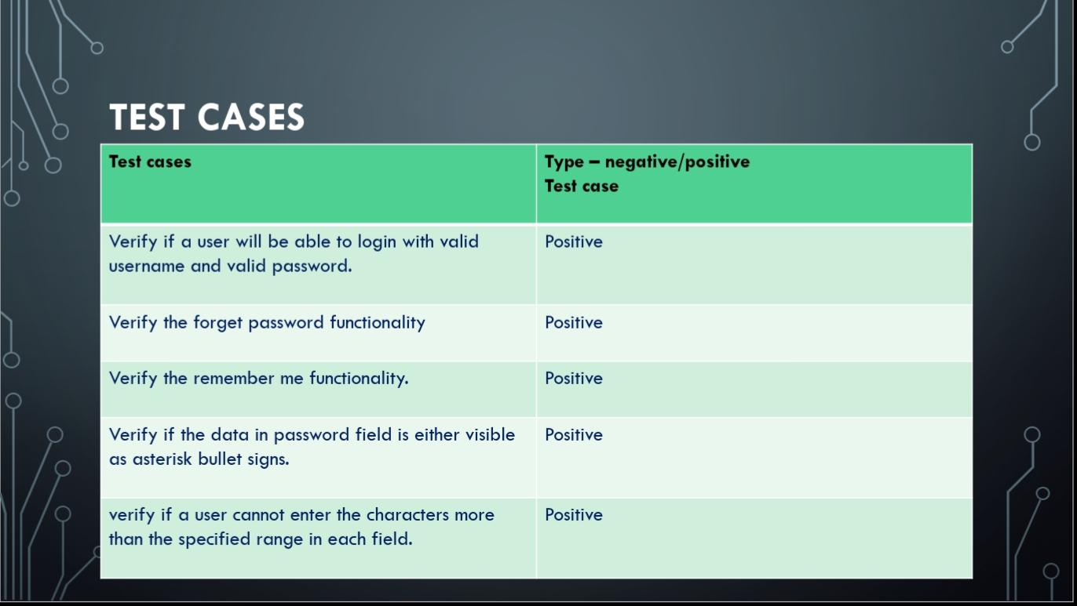
Test cases

Slide 13
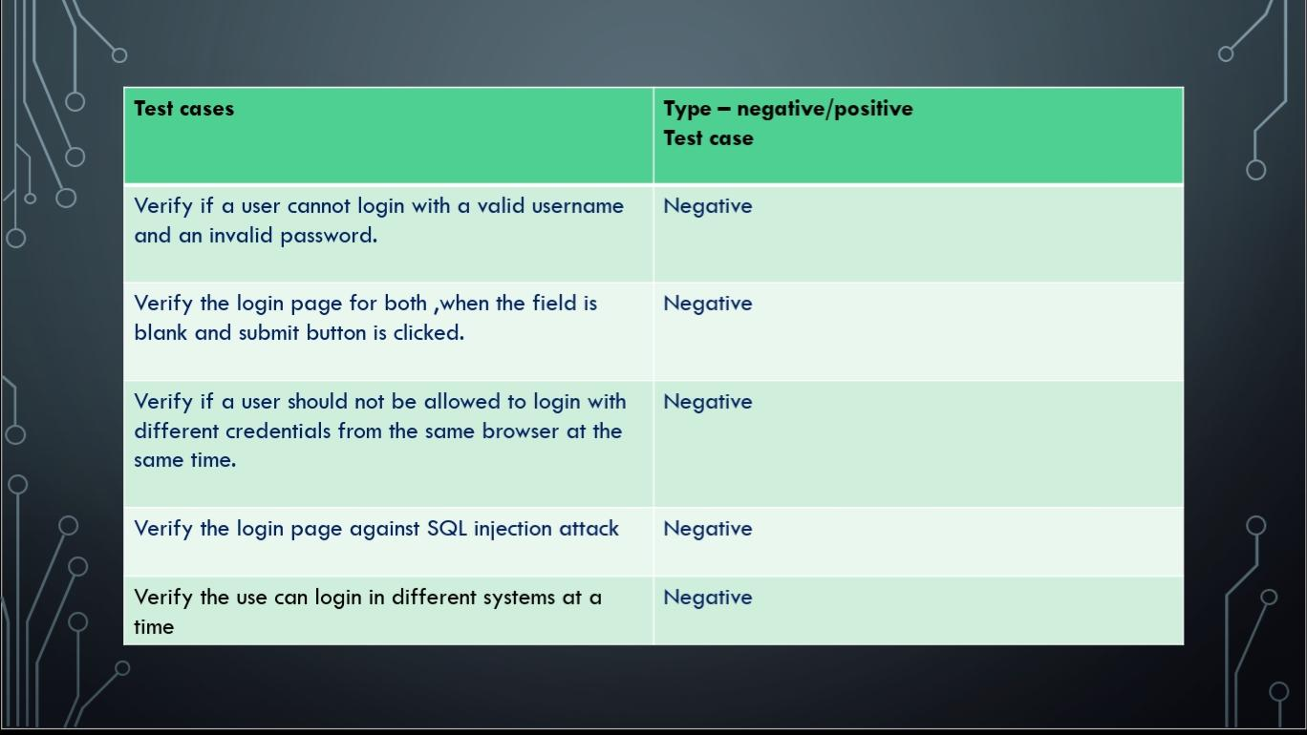

Slide 14
